Slide 1




DEEP LEARNING
Let's Start

Slide 2

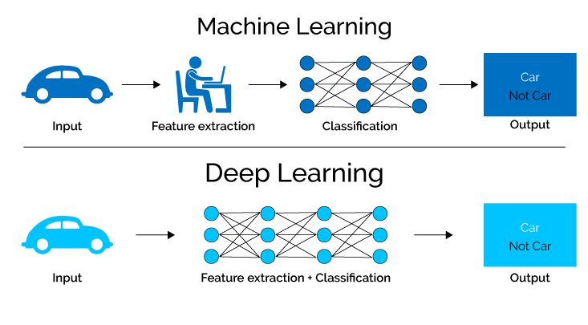
What is Deep Learning
Deep learning is a subset of machine learning, which is essentially a neural network with three or more layers. These neural networks attempt to simulate the behavior of the human brain—albeit far from matching its ability—allowing it to “learn” from large amounts of data. While a neural network with a single layer can still make approximate predictions, additional hidden layers can help to optimize and refine for accuracy.

Slide 3


Perceptron Network
•Perceptron network can implement any type of logical function
We can devise algorithms that can tune the weights and biases of a network of an artificial neurons.

Slide 4
Single Layer Perceptron
It is one of the oldest and first introduced neural networks. It was proposed by Frank Rosenblatt in 1958. Perceptron is also known as an artificial neural network. Perceptron is mainly used to compute the logical gate like AND, OR, and NOR which has binary input and binary output.

Slide 5
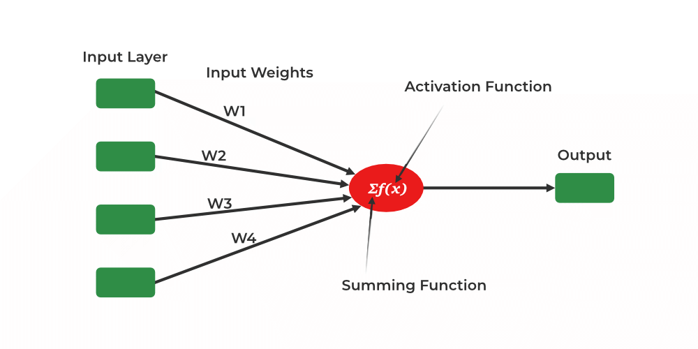

The main functionality of the perceptron are:-
Takes input from the input layer
Weight them up and sum it up.
Pass the sum to the nonlinear function to produce the output.

Slide 6
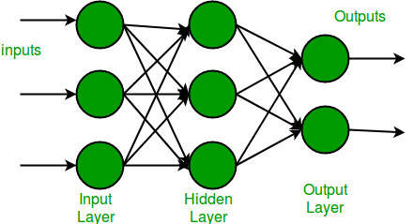
Multi-Layer Perceptron
Multi-layer perception is also known as MLP. It is fully connected dense layers, which transform any input dimension to the desired dimension. A multi-layer perception is a neural network that has multiple layers. To create a neural network we combine neurons together so that the outputs of some neurons are inputs of other neurons.
1/(1+e^(-x))

Slide 7
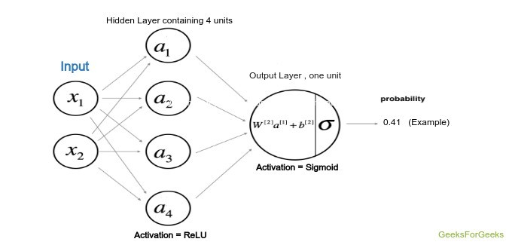
Implementation a deep neural network containing a hidden layer with four units and one output layer.
1. Visualizing the input data
2. Deciding the shapes of Weight and bias matrix
3. Initializing matrix, function to be used
4. Implementing the forward propagation method
5. Implementing the cost calculation
6. Backpropagation and optimizing
7. prediction and visualizing the output

Slide 8
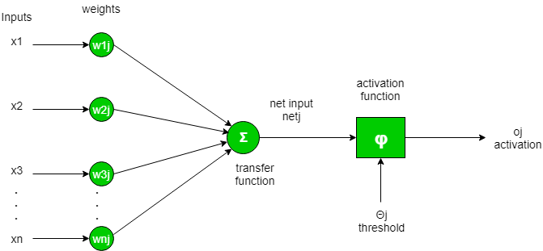
What is Activation Function?
It calculates the ‘weighted sum’ of its inputs and adds a bias, as shown in the figure below by the net input.

Slide 9
Types of Activation Functions
STEP FUNCTION:
3. RELU
f(x)=1, if x>0
f(x)=0, if x<=0
f(x)=max(x,0)
2. SIGMOID FUNCTION:
4. LEAKY RELU
1/(1+e^(-x))
f(x)=ax, if x<0
f(x)=0, if x>=0

